Slide 1
SWARM INTELLIGENCE BASED MAZE SOLVER
Project Members
Digya Acharya(069BEX412)
Pranish Bhagat(069BEX425)
Pratik Bhandari(069BEX427)
Sijan Bhattarai(069BEX438)
Project Supervisor
Mr. Dinesh Baniya Kshatri
Notes:
Good afternoon everyone, I am Pranish Bhagat and my roll number is 069/bex/425

Slide 2
OUTLINE
Motivation
Introduction
Methodology
Result
Conclusion

Slide 3
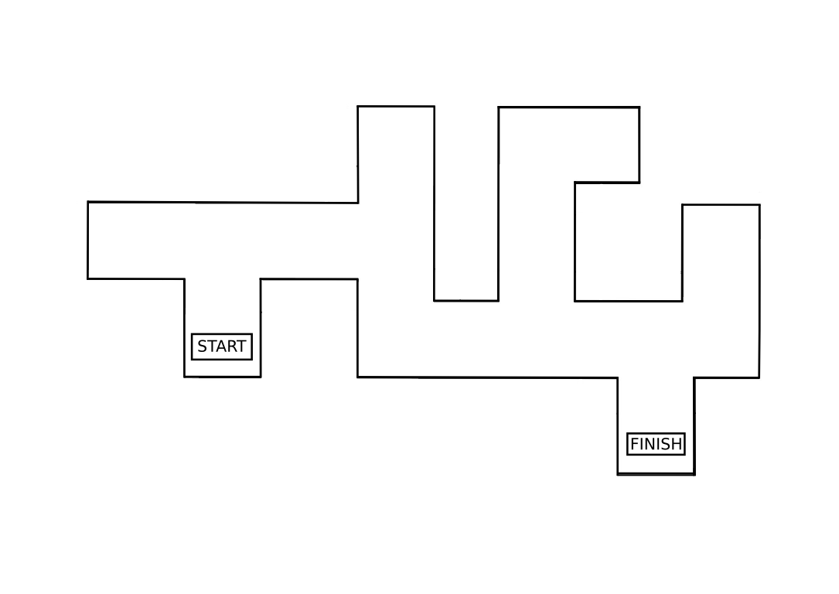
MOTIVATION How can a robot find the shortest path?
Notes:
We can easily determine the shortest path. But how does a robot finds it?

Slide 4
PROBLEM STATEMENT
To demonstrate the concept of Swarm Intelligence
To solve a maze using swarm robotics
To establish an effective communication between two robots
Notes:
Our project is an implementation of concept of swarm which tries to tackle the following problems

Slide 5
INTRODUCTION
Group of robots operate without any form of centralized control
Using local methods of control and communication
Local control – autonomous operation
Local communication – avoids bottlenecks
Scalable – new robots can be added, or fail without need for recalibration
Simplicity – cheap, expendable robots
Self-organization
Notes:
Beginning with swarm, swarm robotics is the study of design of group of robots which operates without any form of central control.

Slide 6
APPLICATIONS OF SWARM
Search And Rescue ( SAR) Operation
Disaster Relief
Landmine Detection and Further Operations
Notes:
Swarm robotics makes a system more appealing in several potential applications; some of which are mentioned here.

Slide 7
PURPOSE OF SWARM INTELLIGENCE
Efficient use of Resources
Autonomous Navigation
Work Division
De-centralization
Unknown Terrain Navigation
Notes:
The question arises? Why swarm?
The target can only be detected with the help of a single robot with the use of sensors. The other following robots do not have to detect the target rather they can follow the directions and reach the target.
They cope well with the failure of a single individual.

Slide 8
METHODOLOGY
Obstacle Detection
Maze Traversal and Target Detection
Path Deduction
Communication
Output
Notes:
Entering into thre methodology section, it has been divided into 5sections: namely;

Slide 9
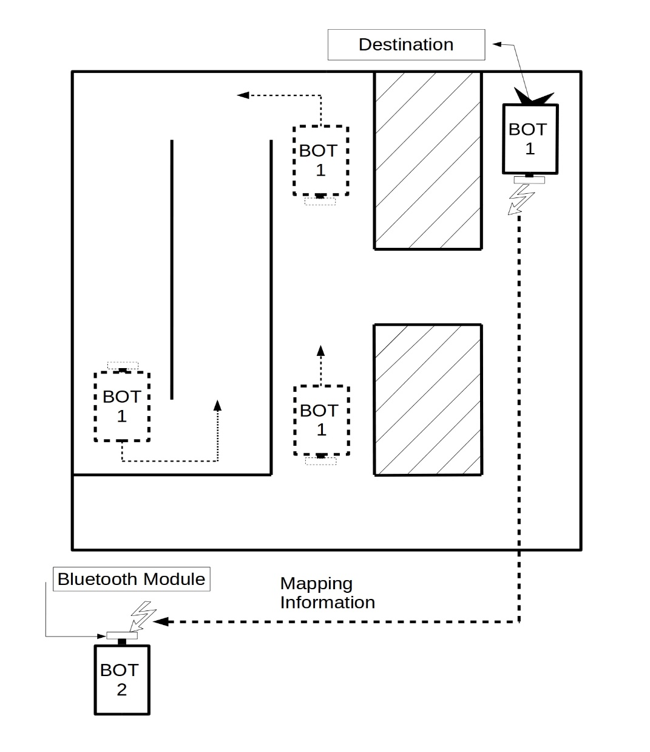
METHODOLOGY System Overview
First Robot
Traverses the whole maze from start to finish implementing the Left Wall Following Algorithm
Relays maze mapping information
Second Robot
Traverse in shortest possible path
Notes:
Lets take a genral overview of the system.

Slide 10
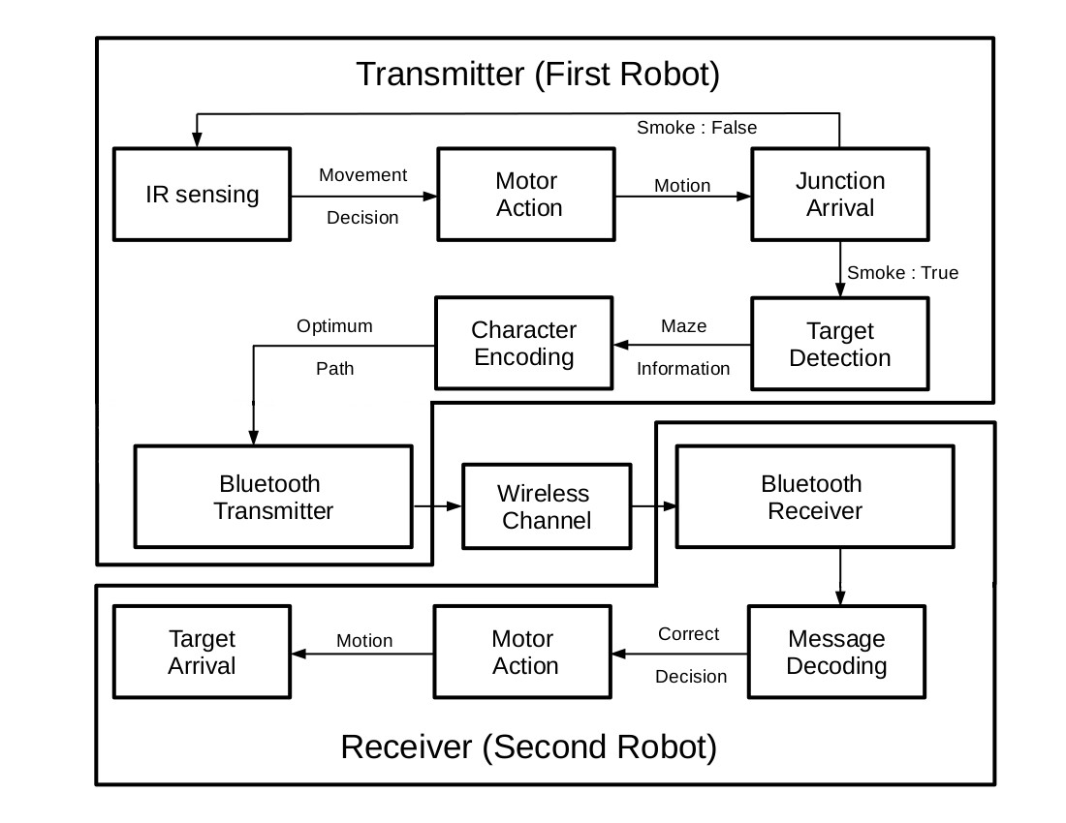
METHODOLOGY Functional Block Diagram
Notes:
This is the functional block diagram.

Slide 11
METHODOLOGY Functional Overview-First Robot
The first robot traverses the entire maze. (non-optimal path)
Implementing left wall following algorithm.
Detects the target.
Sends the optimized path to the second robot.

Slide 12
METHODOLOGY Functional Overview-Second Robot
The second robot receives the optimized path from the first robot.
Traverses the maze in the shortest path possible.

Slide 13
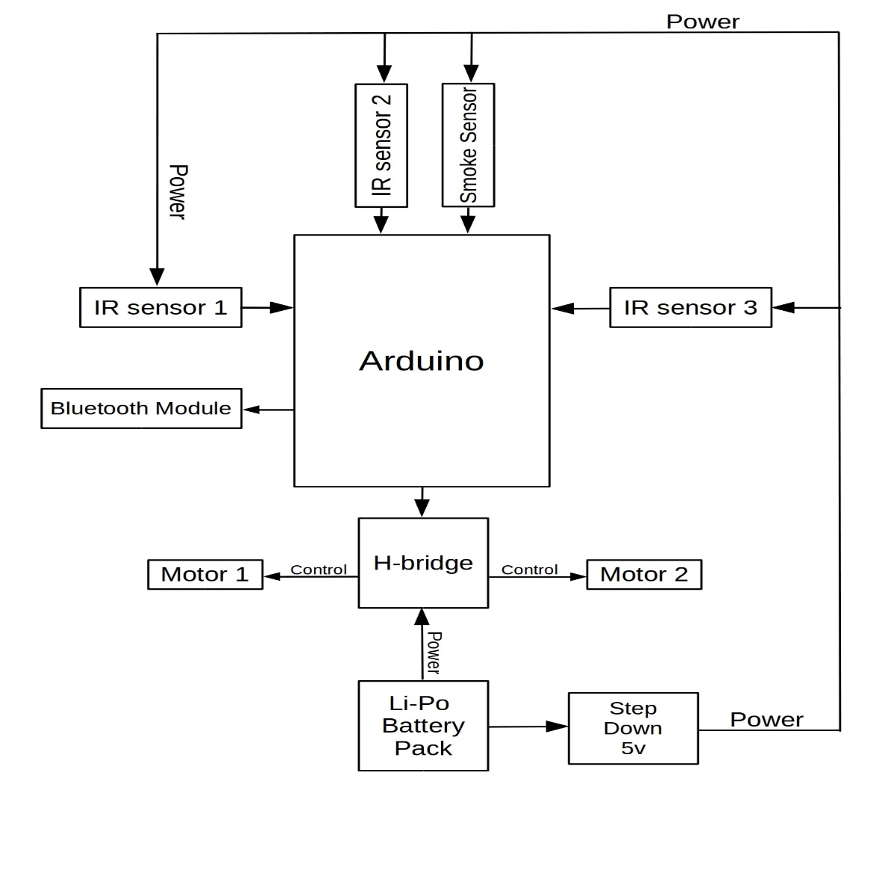
METHODOLOGY First Robot Schematic

Slide 14
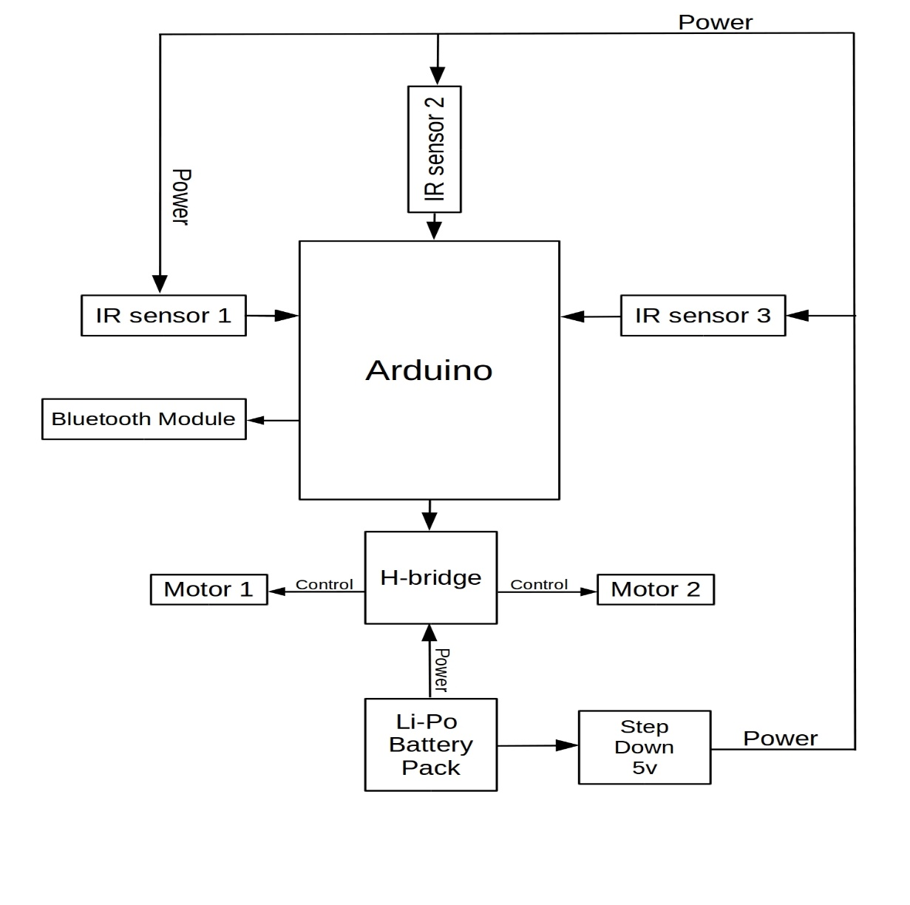
METHODOLOGY Second Robot Schematic

Slide 15
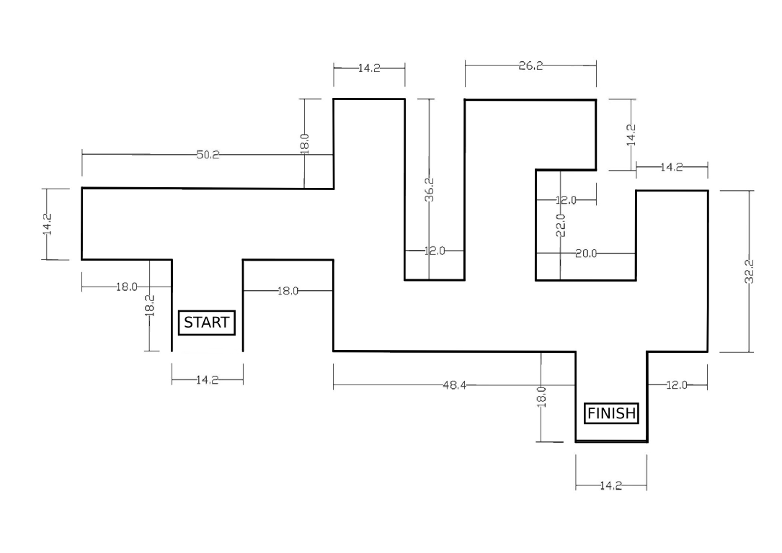
METHODOLOGY Structure of The Maze
Height of the Wall: 8 inches

Slide 16
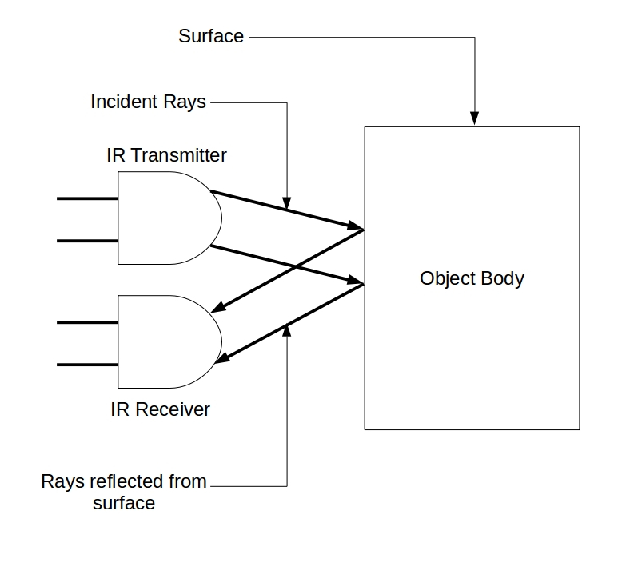
METHODOLOGY Obstacle Detection
Detection Carried Out Through IR Sensors FC-51
IR Transmitter
IR Receiver

Slide 17
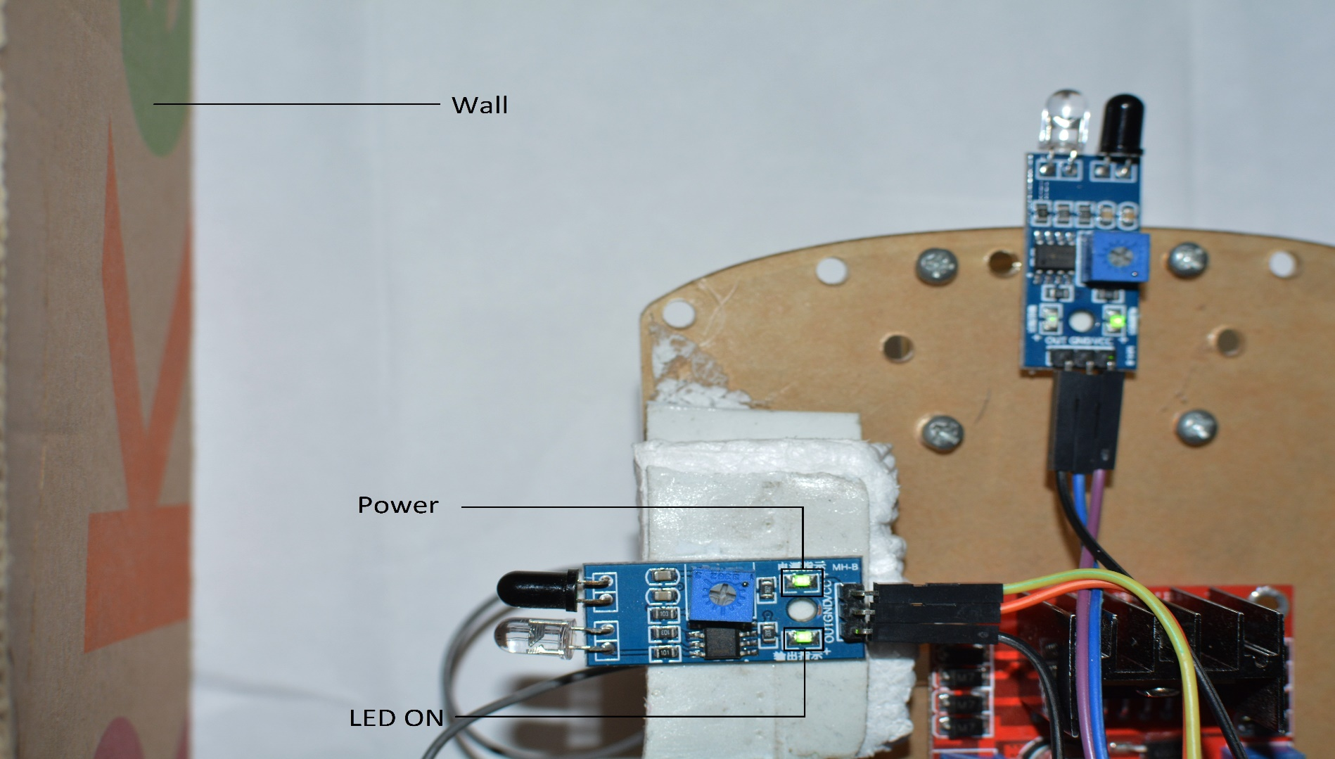
METHODOLOGY Obstacle Detection-Left Wall

Slide 18
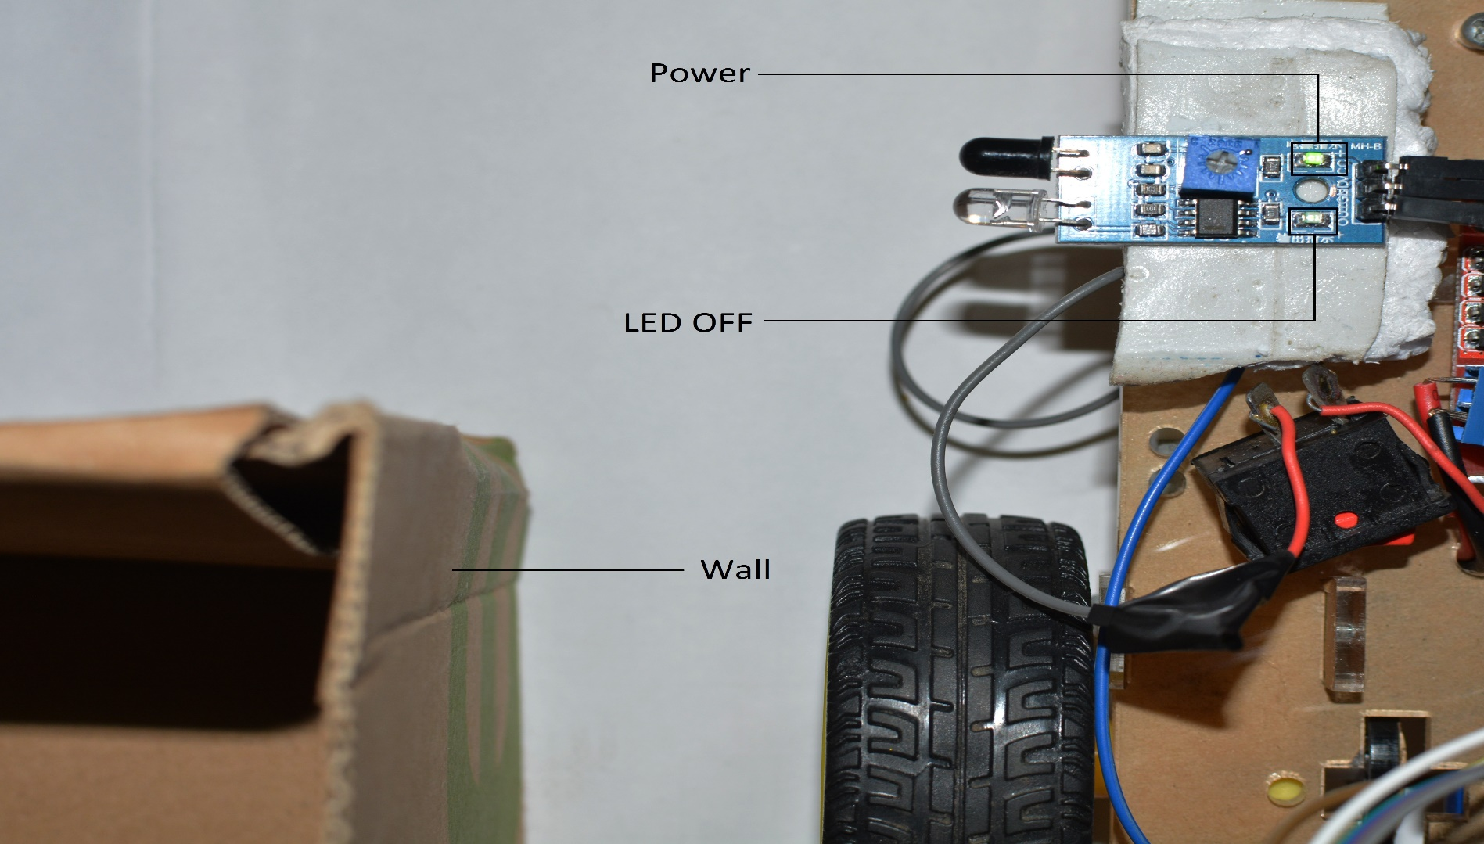
METHODOLOGY Obstacle Detection-Left Wall

Slide 19
METHODOLOGY Maze Traversal-First Robot
Left Wall Following Algorithm
Robot will reach the target by keeping track of the left wall
Priorities | Direction
1 | Left
2 | Straight
3 | Right
4 | U-Turn

Slide 20
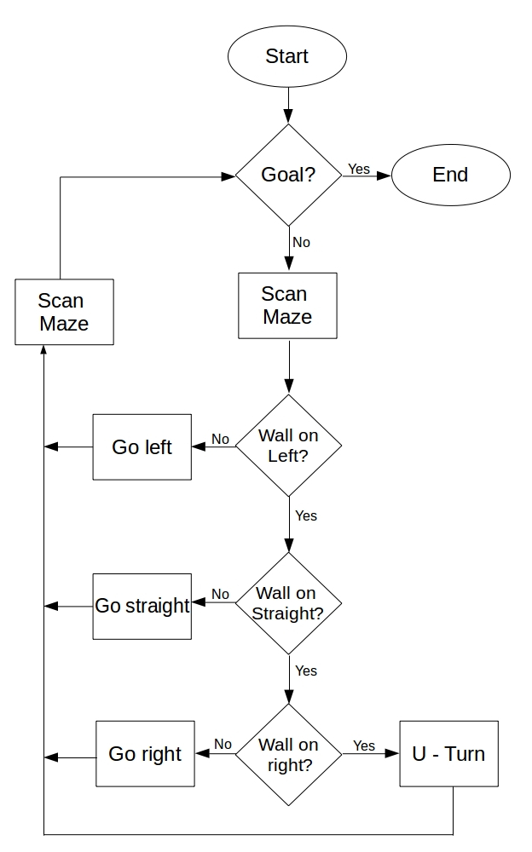
METHODOLOGY Maze Traversal-First Robot
Algorithm

Slide 21
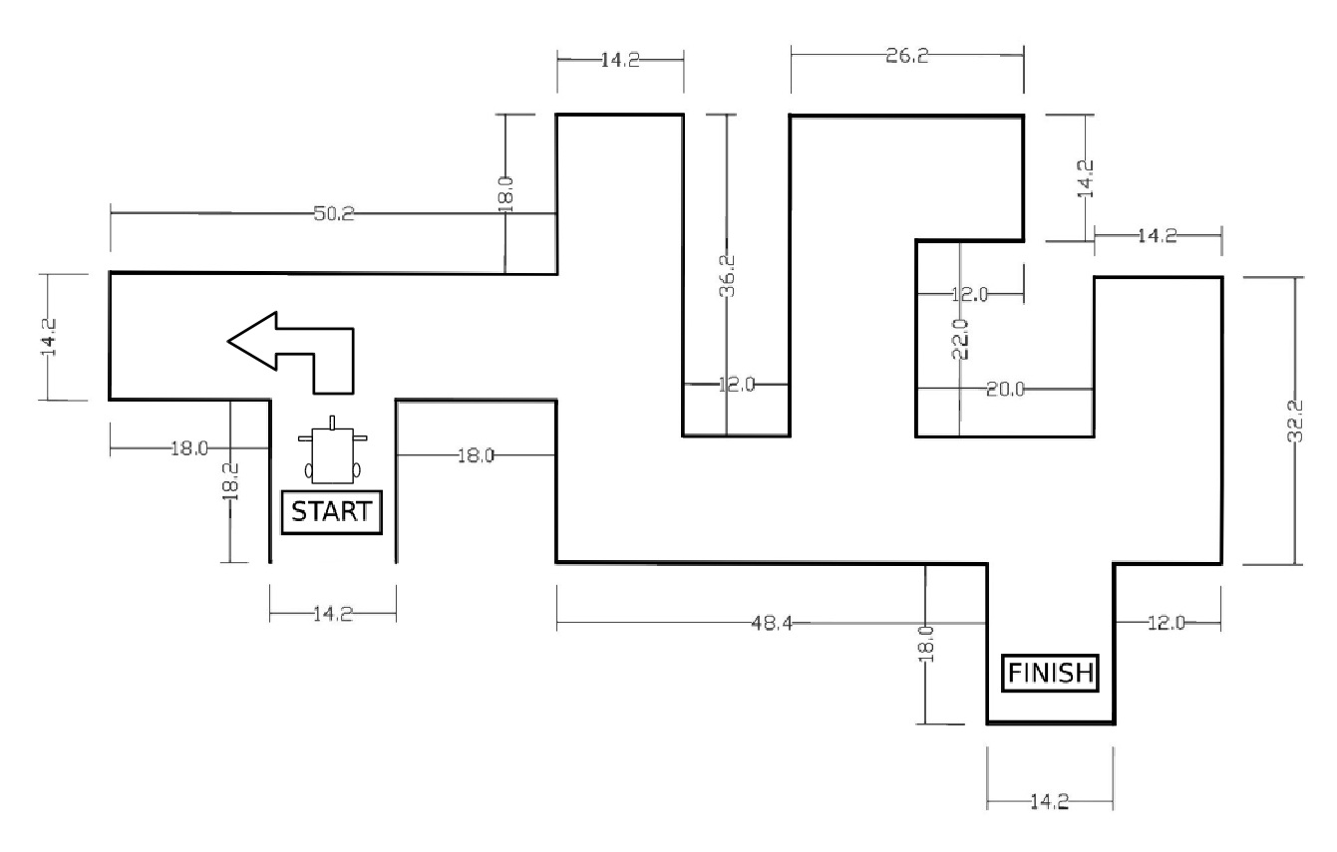
METHODOLOGY Maze Traversal-First Robot

Slide 22
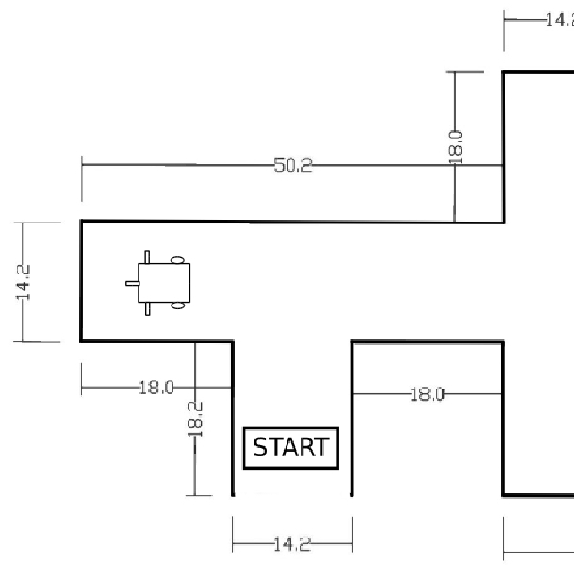
METHODOLOGY Maze Traversal-First Robot

Slide 23
METHODOLOGY Target Detection
Target : Smoke
Target detected using MQ-2 Smoke Sensor
Smoke generated using incense
Spreading contained with enclosure

Slide 24
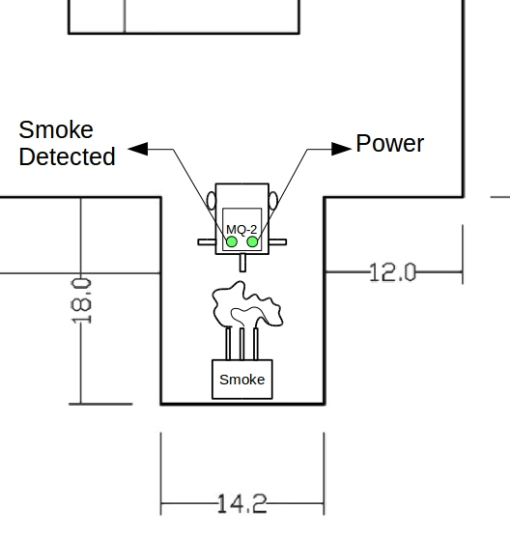
METHODOLOGY Target Detection

Slide 25
METHODOLOGY Path Deduction
The path followed by the first robot.
1
2
3
4
S | L | U | S | L | U | S | L | U | L | S | U | L

Slide 26
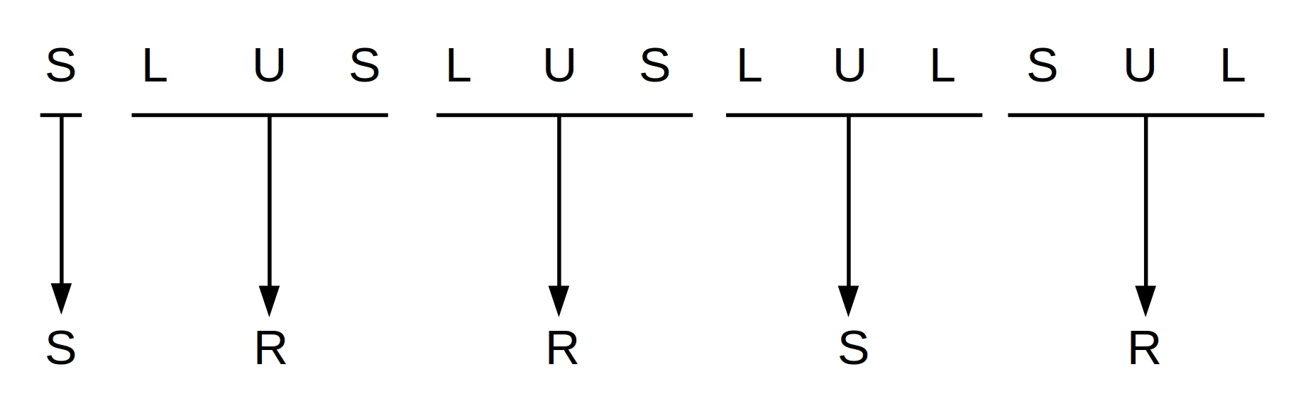
METHODOLOGY Path Deduction
The optimal decisions required for shortest path.

Slide 27
METHODOLOGY Path Deduction
The deduced path stored in an array.
This array is sent to the second robot.
S | R | R | S | R | U

Slide 28
METHODOLOGY Bluetooth Communication
The deduced path sent to the robot via Bluetooth.
Two HC-05 used for interfacing the Arduinos’.
HC-05 used as master in the first robot
Used as slave in the second robot
Serial Communication is established.
Data transfer only from the first to the second robot

Slide 29
METHODOLOGY Bluetooth Communication
Asynchronous Connectionless Packet’s Payload i.e. only data is sent to the second robot.
The decoded array used as the payload for the wireless transfer.
S | R | R | S | R | U

Slide 30
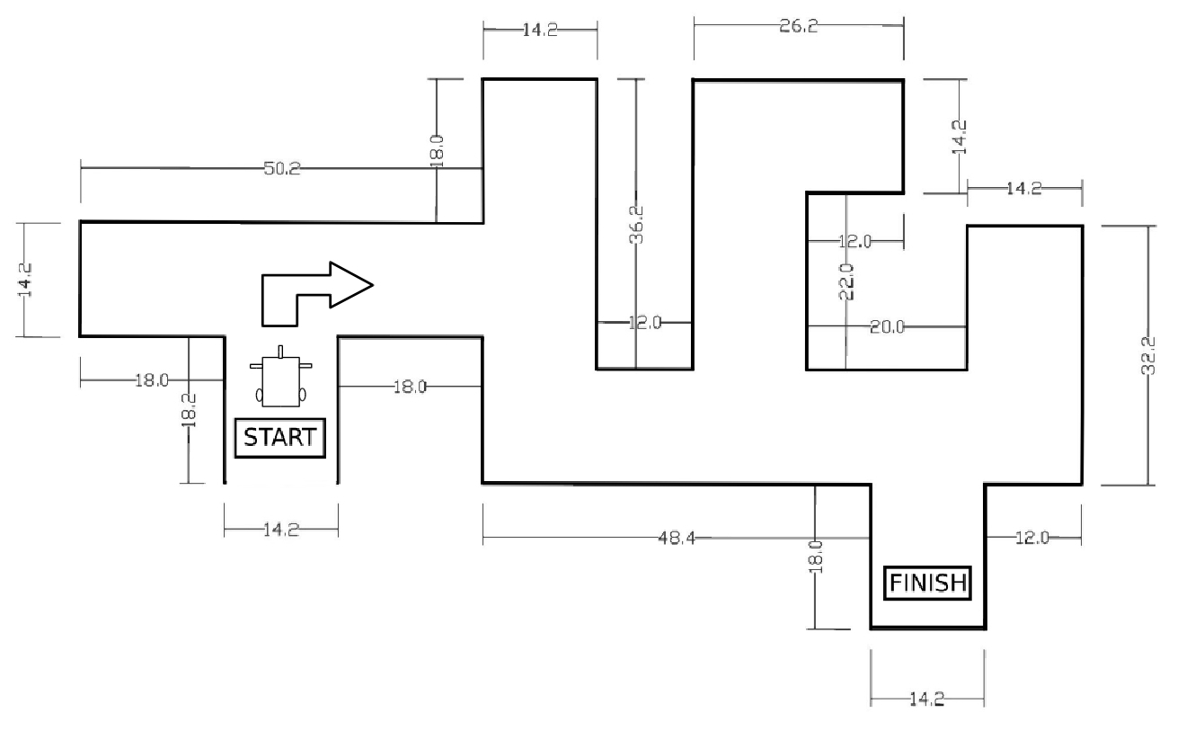
METHODOLOGY Optimal Path Traversal
Upon receiving the optimal path, the second robot traverses the maze avoiding wrong turns

Slide 31
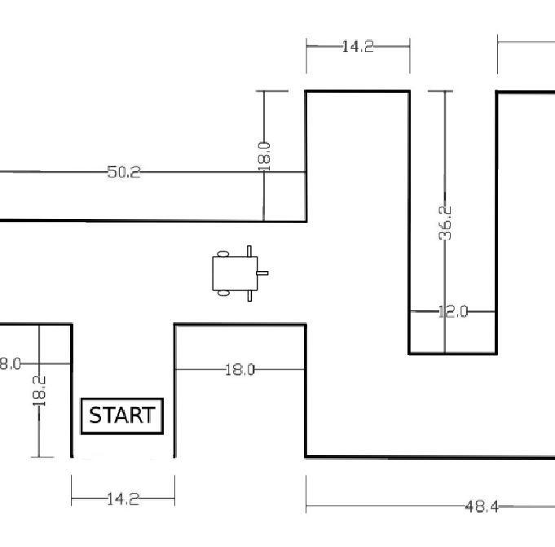
METHODOLOGY Optimal Path Traversal

Slide 32
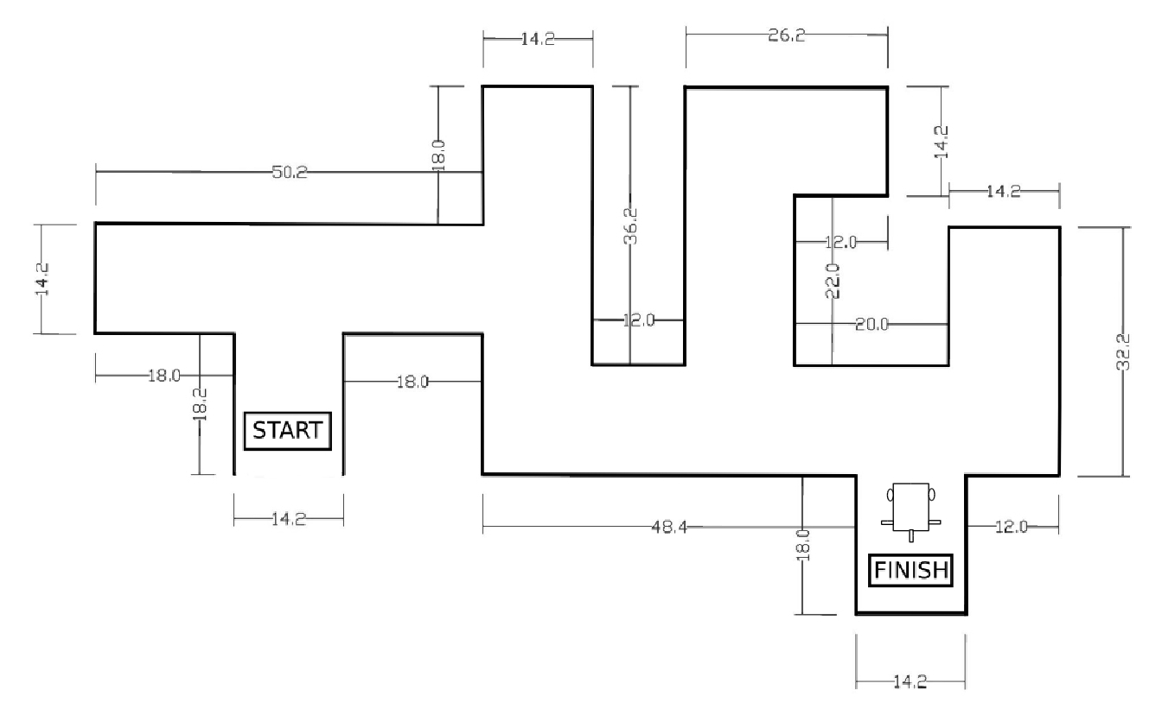
METHODOLOGY Optimal Path Traversal

Slide 33
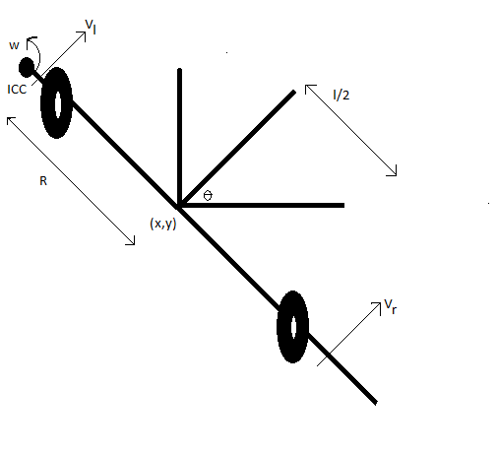
METHODOLOGY Differential Kinematics
Consists of 2 drive wheels
Has high degree of
freedom i.e. 3

Slide 34
METHODOLOGY H-Bridge L298N
Used to interface motor with Arduino
Contains four switching element.
Load at center.

Slide 35
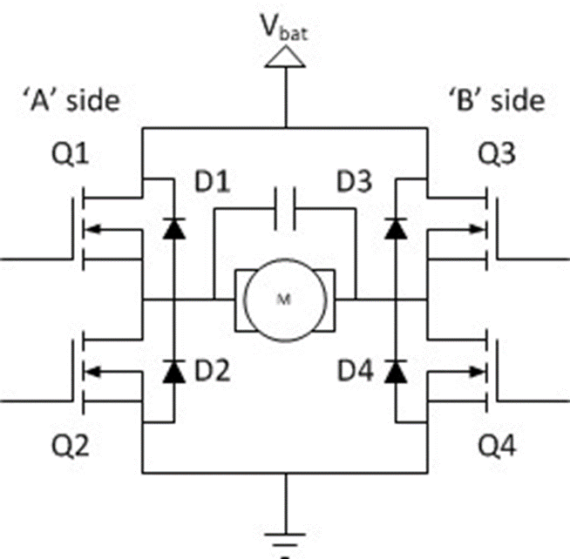
METHODOLOGY H-Bridge L298N
Q1 | Q2 | Q3 | Q4 | RESULT
1 | 0 | 0 | 1 | Motor moves right
0 | 1 | 1 | 0 | Motor moves left
0 | 0 | 0 | 0 | Motor coasts
0 | 1 | 0 | 1 | Motor brakes
1 | 0 | 1 | 0 | Motor brakes
1 | 1 | 0 | 0 | Short circuit
0 | 0 | 1 | 1 | Short circuit
1 | 1 | 1 | 1 | Short circuit
Notes:
For passing the high frequency component and preventing the loss of MOSFET, capacitor is used.

Slide 36
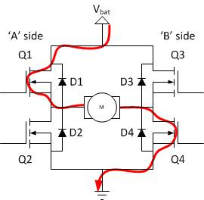
METHODOLOGY H-Bridge L298N
Figure : Motor moves in forward direction.

Slide 37
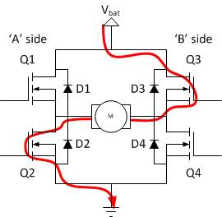
METHODOLOGY H-Bridge L298N
Figure : Motor moves in reverse direction.

Slide 38
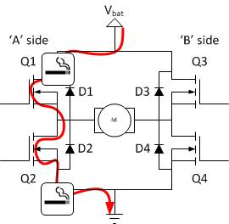
METHODOLOGY H-Bridge L298N
Figure : Motor stops due to Short Circuit

Slide 39
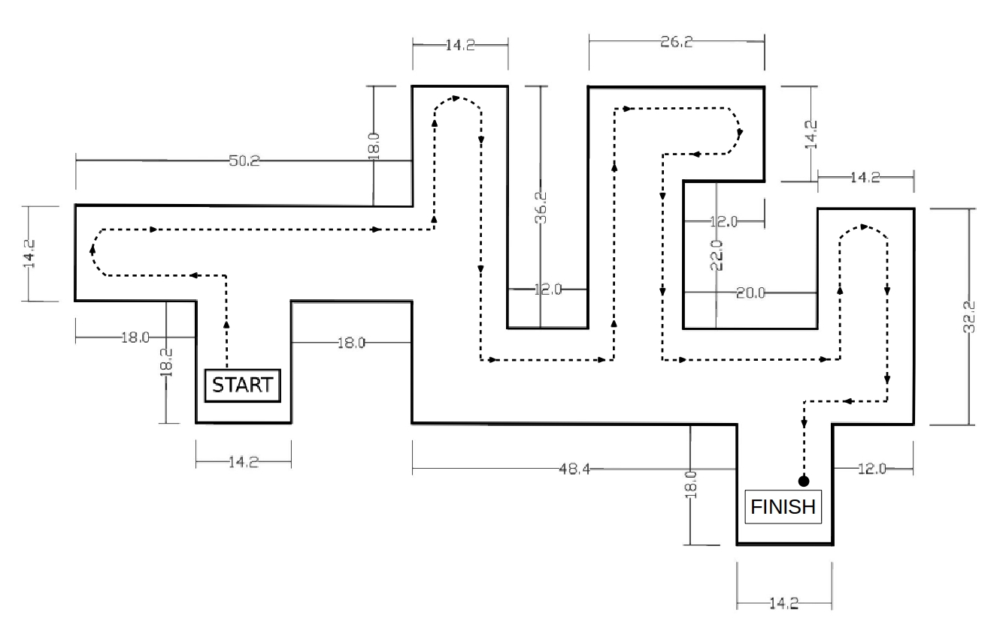
RESULTS Path Traversed-First Robot(Expected)

Slide 40
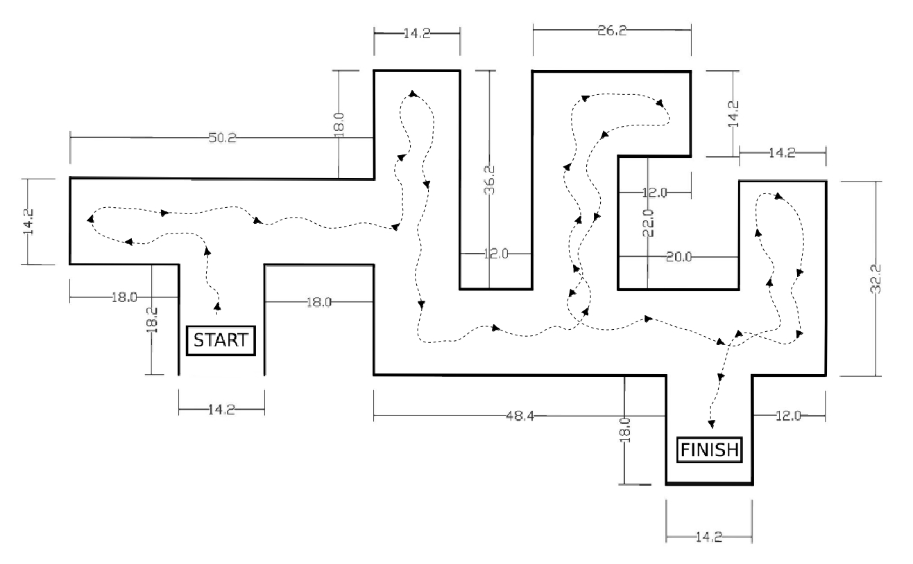
RESULTS Path Traversed-First Robot(Obtained)

Slide 41
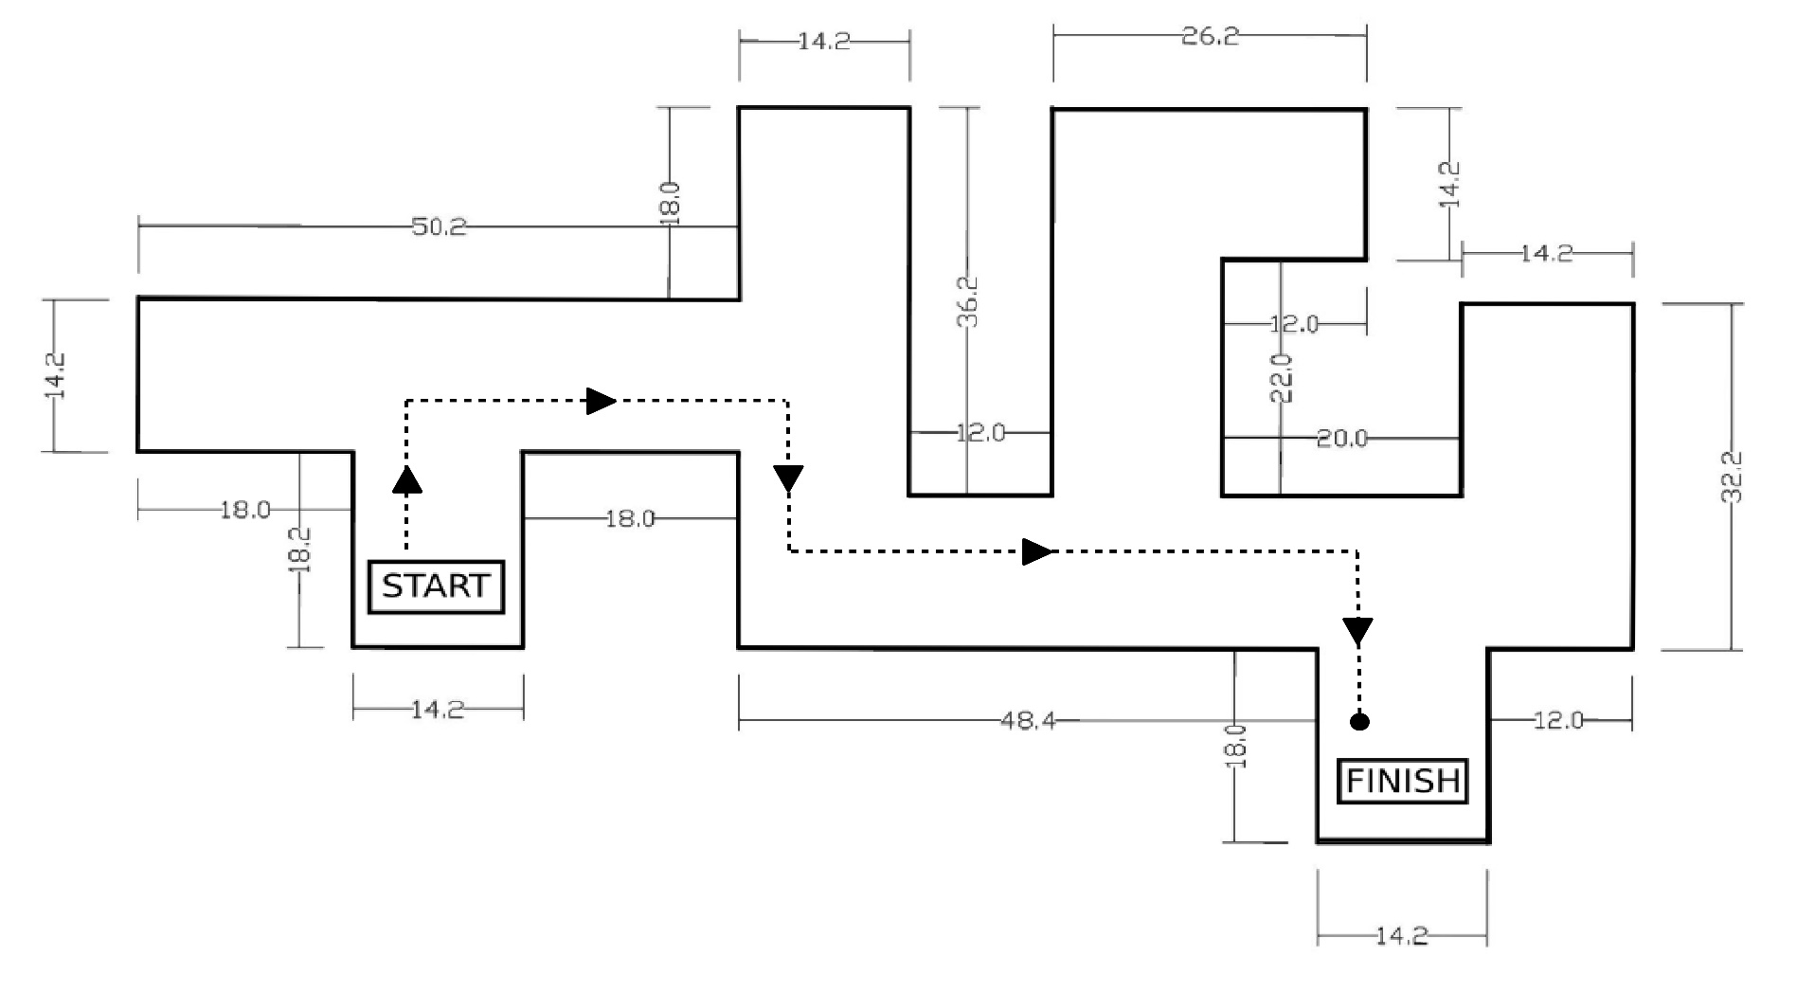
RESULTS Path Traversed-Second Robot (Expected)

Slide 42
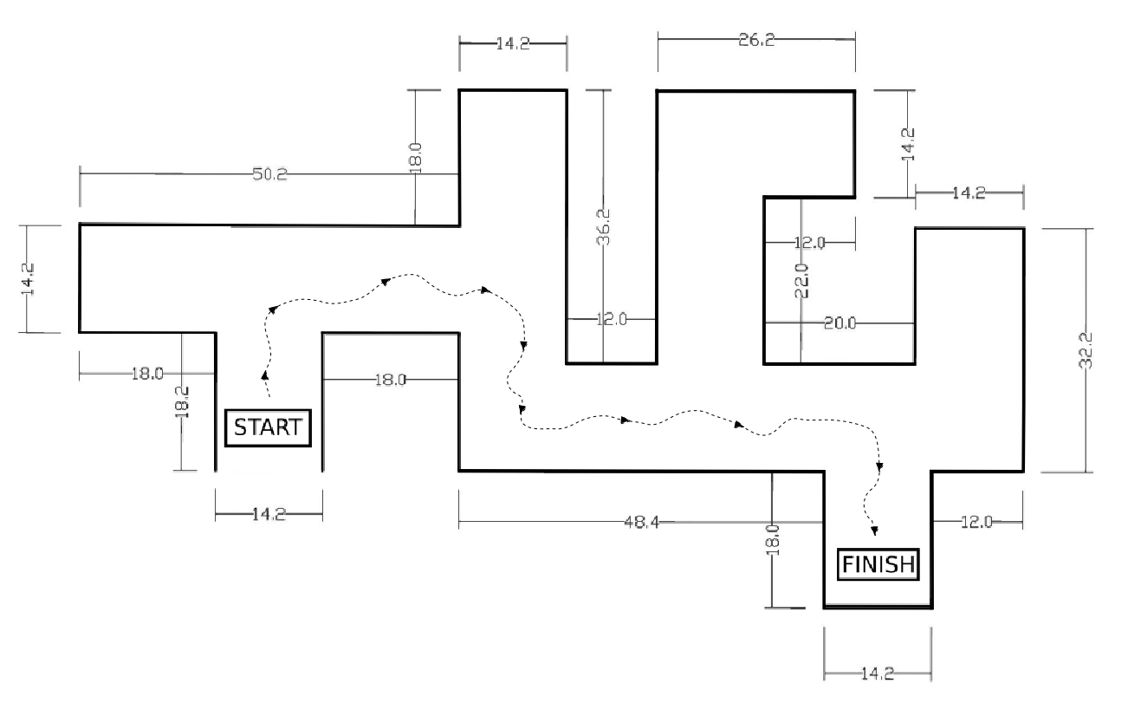
RESULTS Path Traversed-Second Robot (Obtained)

Slide 43
CONCLUSION
Visualized the concept of Swarm Intelligence
Not limited to Maze Solving
Limitations of Bluetooth Communication
A swarm of simple robots can be made intelligent

Slide 44
REFERENCES
B. W. D.H. Barnhard, J.T. McClain and W. Potter, “Odin and hodur: Using Bluetooth communication for coordinated robotic search,” The University of Georgia, Tech. Rep
B. F. V. Gazi, “Coordination and control of multi-agent dynamic systems: Models and approaches,” in Swarm Robotics, Springer, 2007, pp. 71–102.
D. B. Michael Gims, Sonja Lenz. (1999, May) Microprocessor controlled vehicle. [Online]. Available: http://www.dbecker.de/sites/default/files/micromouse.pdf
S. P. Y. Mohan, “An extensive review of research in swarmrobotics in nature and biologically inspired computing,” World Congress on, IEEE, vol. 1, pp. 140–145, 2009.
M. S. L. Iocchi, D. Nardi, “Reactivity and deliberation: a survey on multi-robot systems,” in Balancing reactivity and social deliberation in multi-agent systems, Springer, 2001, pp. 9–32.
Infrared obstacle avoidance proximity sensors module fc-51 – art of circuits.
(2011) Arduino - arduinoboarduno. [Online]. Available: https://www.arduino.cc/en/ Main/ArduinoBoardUno

Slide 45
THANK YOU

